Slide 1
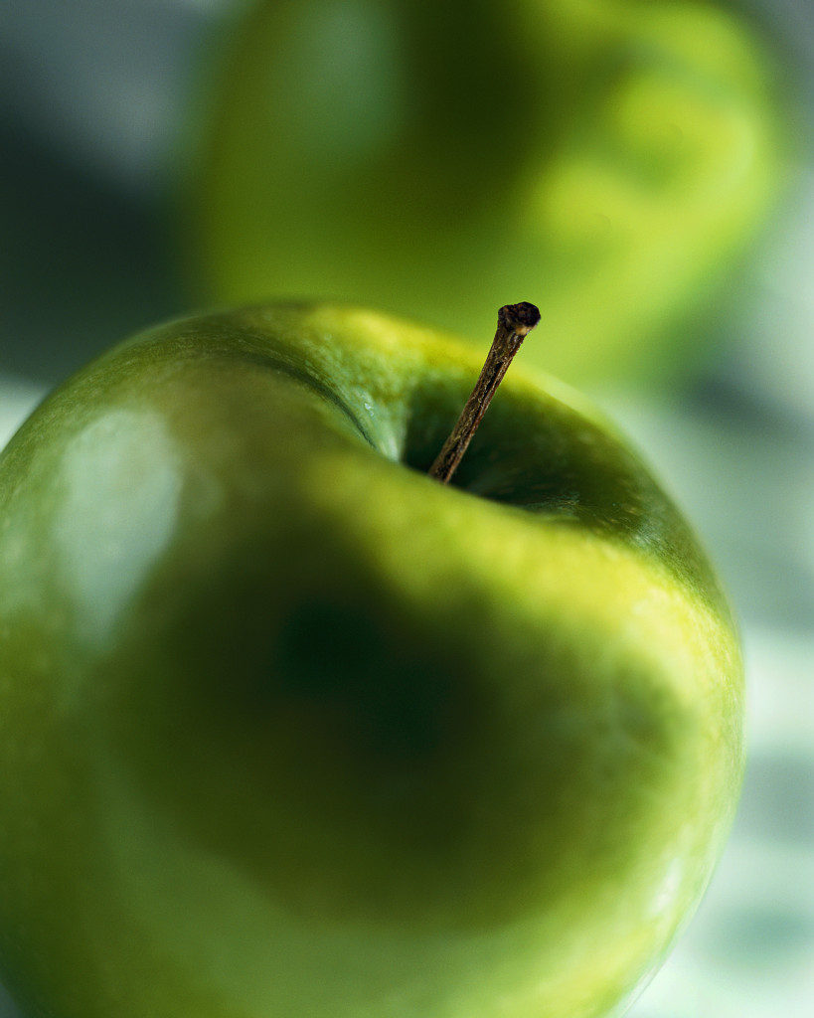
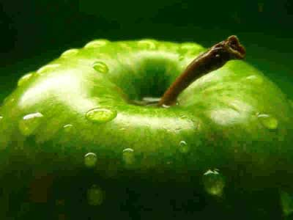



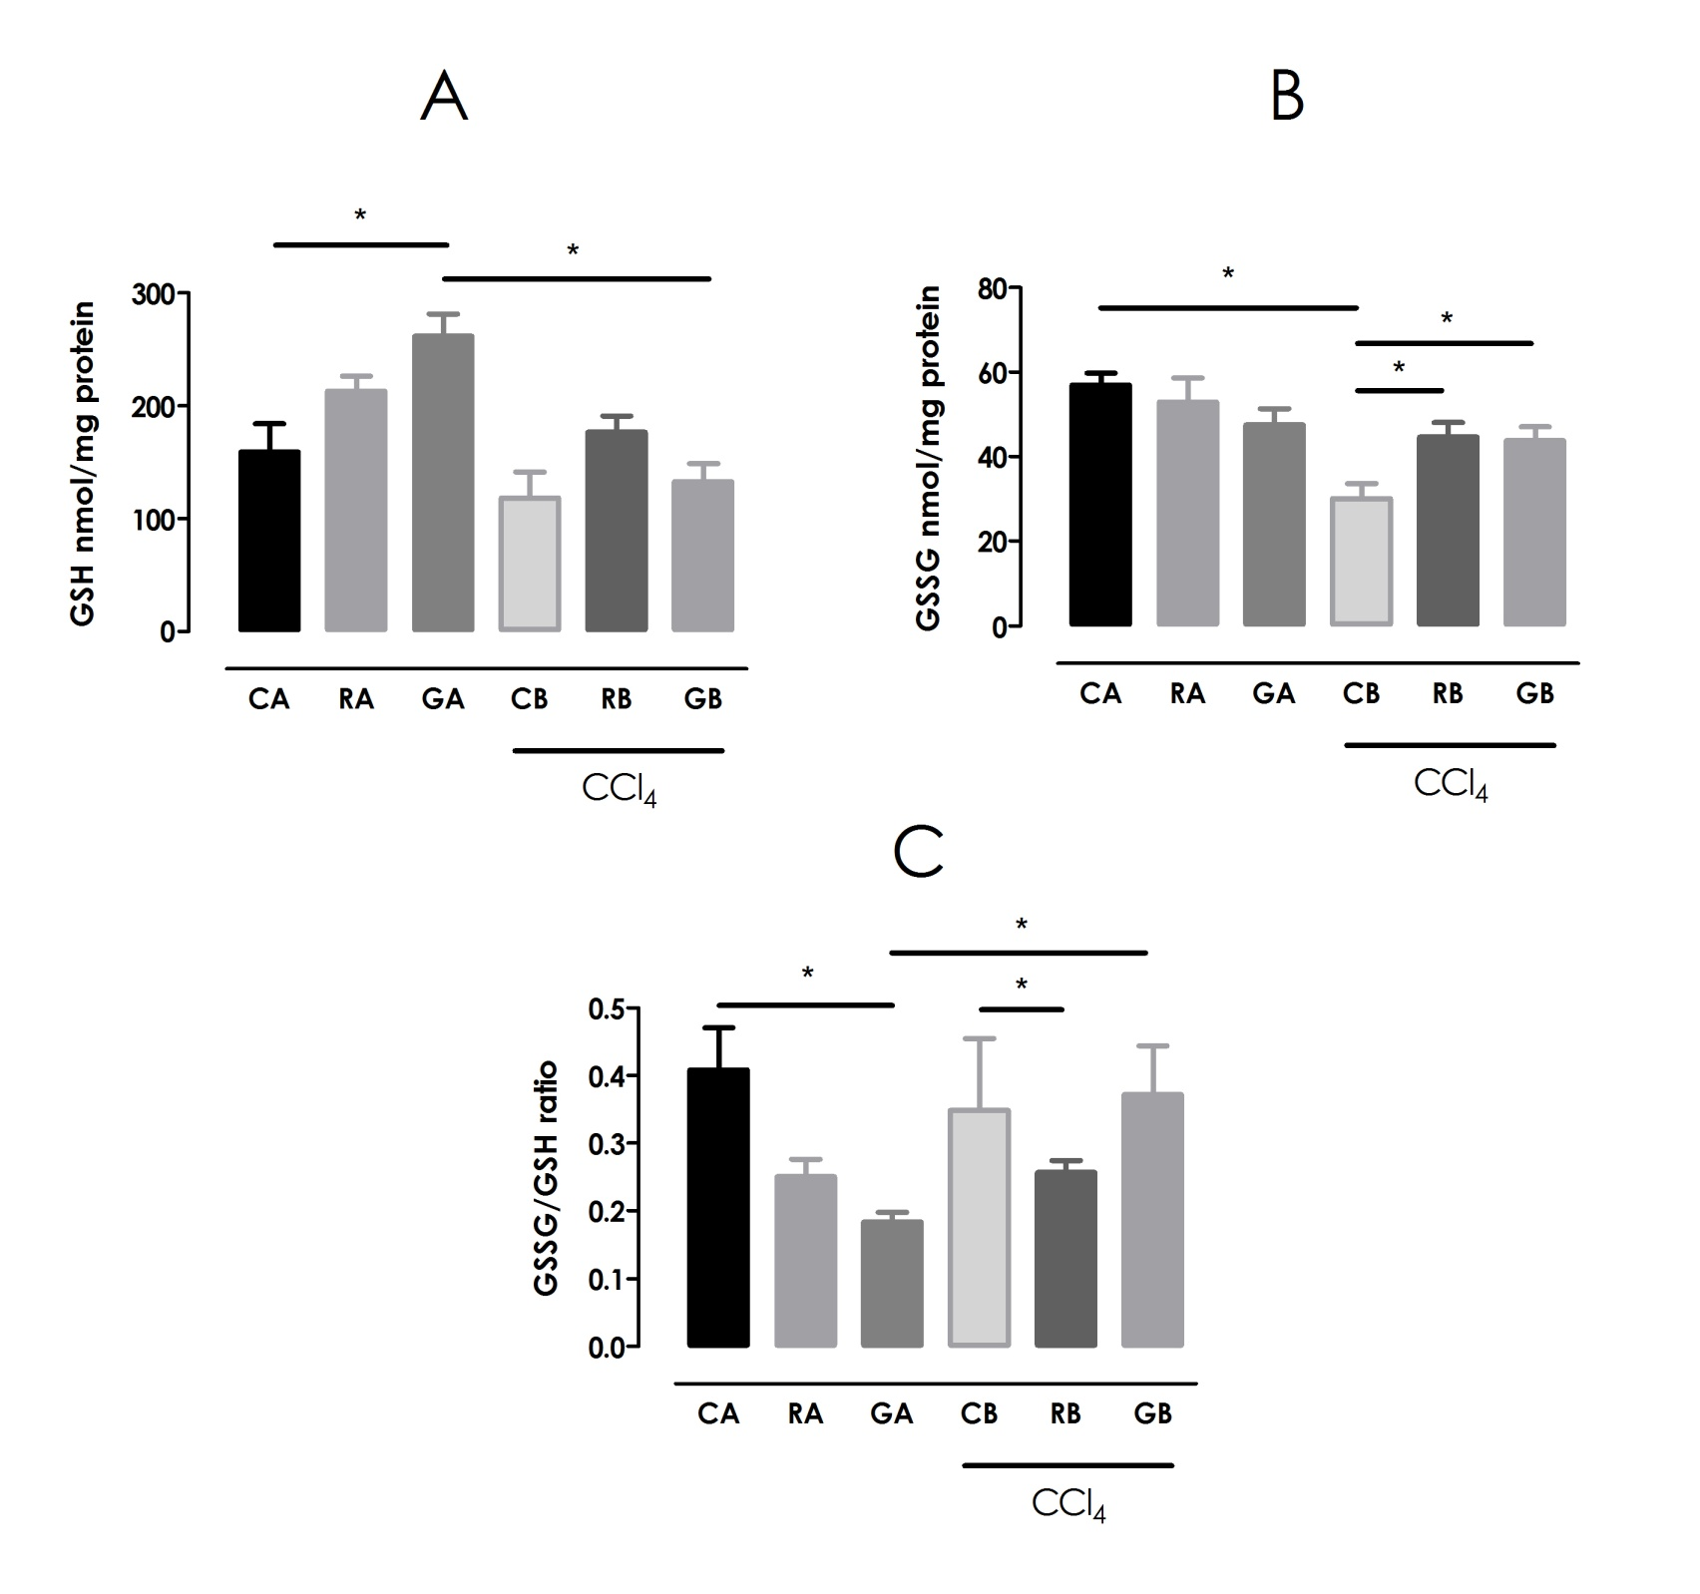
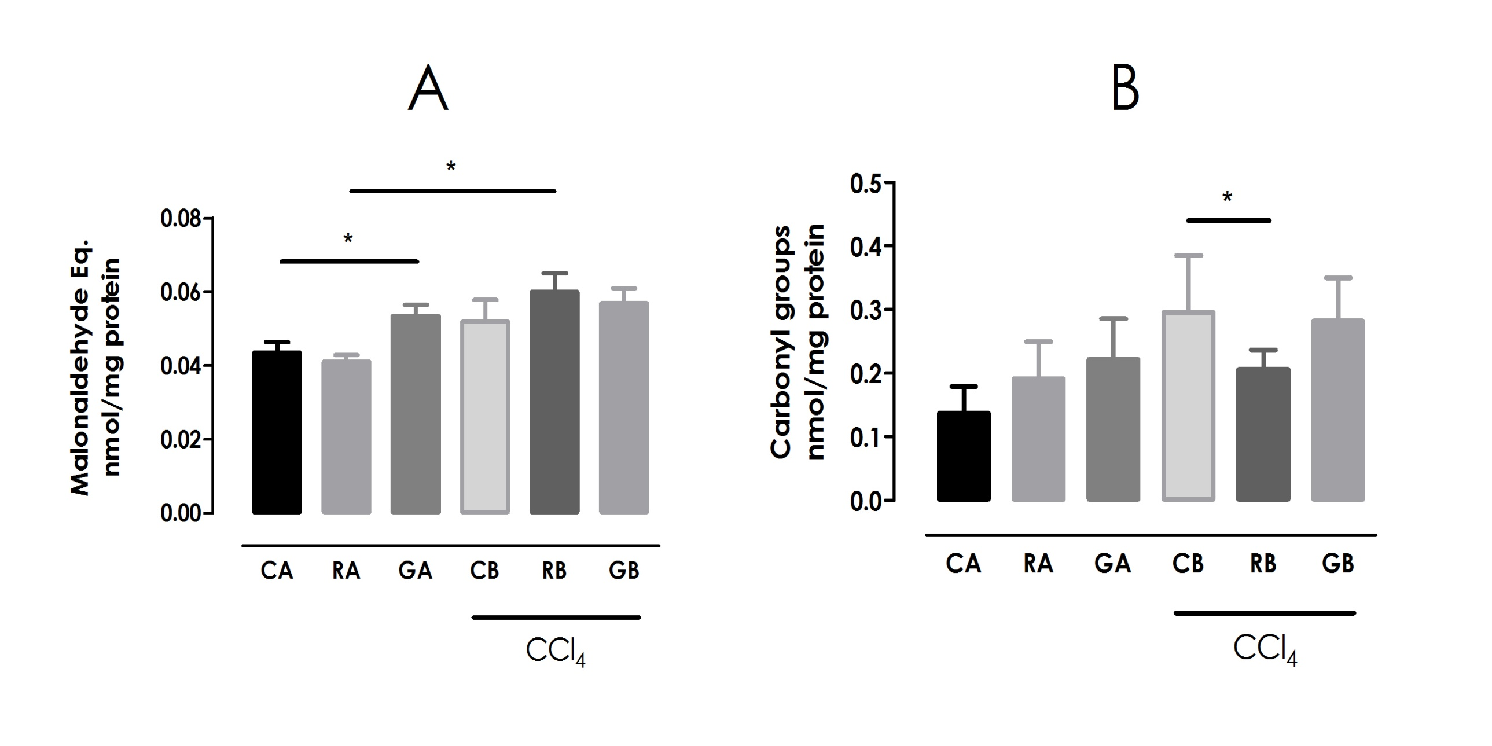
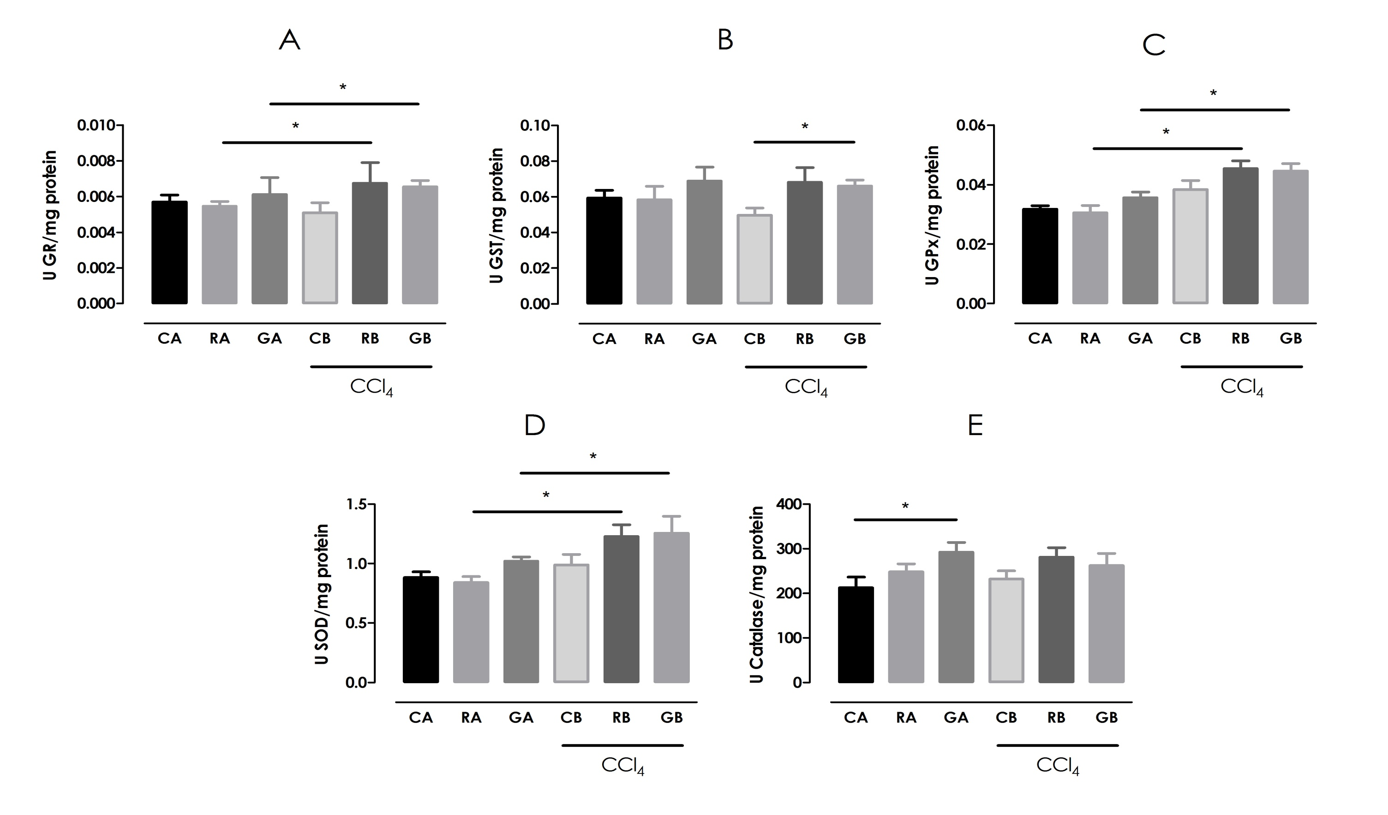
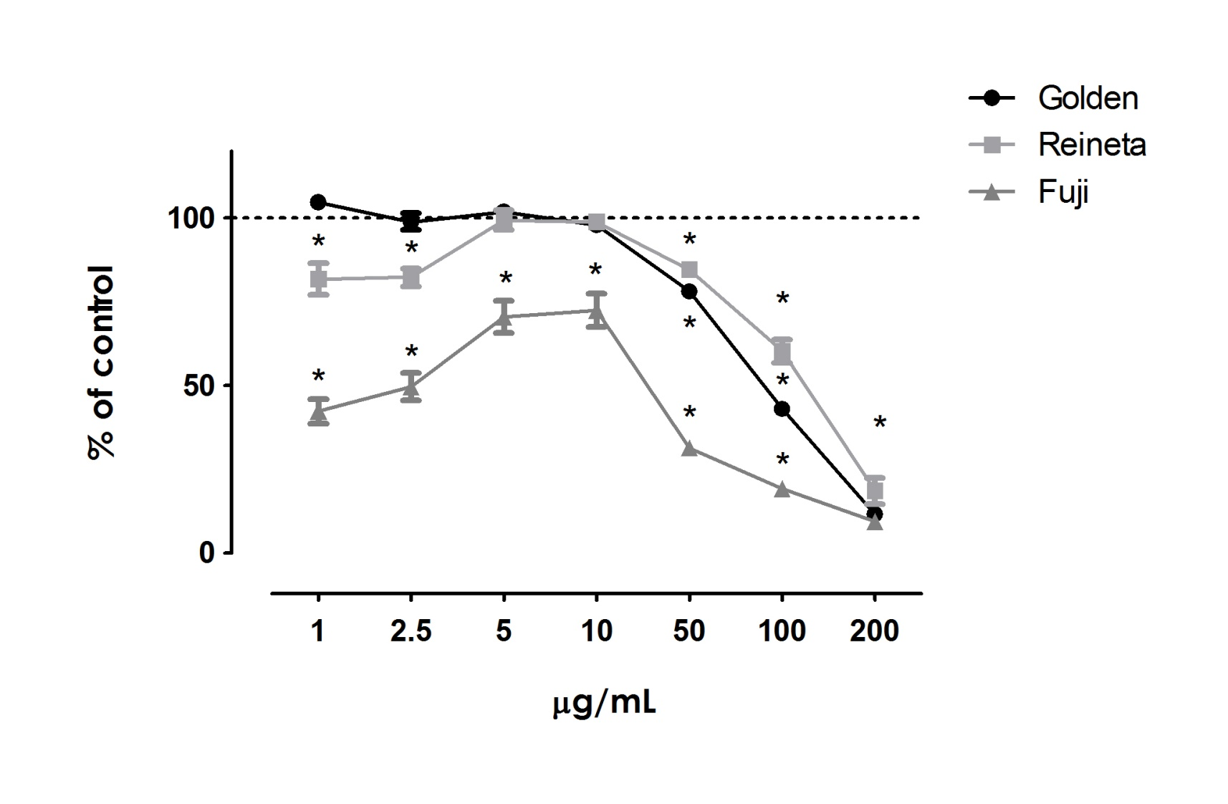
Apple phytochemicals - effects on redox status and tumour cell proliferation
Pestana D¹*, Faria A^{1,2}, Gião M³, Teixeira D¹, Monteiro R¹, Pintado M³, Almeida DPF^{3,4}, Calhau C¹
¹ Serviço de Bioquímica (U38-FCT), Faculdade de Medicina da Universidade do Porto, 4200-319 Porto;
² Centro de Investigação em Química (CIQ), Departamento de Química, Faculdade de Ciências da Universidade do Porto, 4169-007 Porto;
³ Escola Superior de Biotecnologia do Porto, Universidade Católica Portuguesa, 4200-072 Porto;
⁴ Faculdade de Ciências, Universidade do Porto, 4150-180 Porto, Portugal.
Results
Evaluation of in vivo redox status
Background
There is an increasing interest in the identification of dietary factors capable of reducing the risk of chronic pathology manifestations, in particular, through the regulation of oxidative stress ¹⁻⁵.
Apples are a widely consumed rich source of phytochemicals, and epidemiological studies have linked the apples consumption with reduced risk of some cancers, cardiovascular disease and diabetes ⁶⁻⁷.
Different phytochemicals may have diverse biological activities, including antioxidant and anti-proliferative activity. Chlorogenic acid, phloridzin and phloretin are some of the major individual phytochemicals in apple ⁸⁻¹⁰.
Figure 1. Effect of 6 weeks of treatment on hepatic oxidation of (A) lipids and (B) proteins. Values are represented as mean ± S.E.M. (n= 6). Statistical analysis with t test: * P < 0.05.
Figure 2. Effect, after 6 weeks of treatment, upon hepatic gluthatione content: (A) GSH, (B) GSSG and the (C) GSSG/GSH ratio. Values are represented as mean ± S.E.M. (n = 6). Statistical analysis with t test: * P < 0.05.
Aim. To evaluate the bioactive properties of apples from Alcobaça (PGI), in modulation of redox status and tumour cell proliferation.
Figure 3. Effect, after 6 weeks of treatment, upon hepatic activity of glutathione dependent enzymes: (A) GR, (B) GST, (C) total GPx; and hepatic activity of the antioxidant enzymes (D) SOD and (E) catalase. Values are represented as mean ± S.E.M. (n = 6). Statistical analysis with t test: * P < 0.05.
Methods
Evaluation of in vivo redox status
Animal treatment. Thirty-six male CD-1 mice (Charles River Laboratories España S.A., Barcelona, Spain), 30-35 g bw, were divided and treated for 6 weeks. Treatments consisted in 3 control groups (C- water, R- phenolic extract from ‘Reinette’ apple, G- phenolic extract from ‘Golden Delicious’ apple ) and 3 parallel groups with CCl4 aggression (CA, RA, GA). All groups ingested proper chow for laboratory animals.
Hepatic redox status. Determination of lipid peroxidation (thiobarbituric acid reactive substance assay – TBARS ¹¹), protein oxidative damage (quantification of carbonyl content), as described in literature ¹². Measurement of gluthatione (GSH and GSSG) content ¹³, and the activity of the dependent enzymes, GPx (glutathione peroxidase) ¹⁴, GR (glutathione reductase) ¹⁵ and GST (glutathione-S-transferase) ¹⁶. Activity determination of antioxidant enzymes, catalase ¹⁷ and SOD (superoxide dismutase) ¹⁸.
Effect on tumour cell proliferation
Phenolic extracts from three apple cultivars
in HT-29 cell line
Individual phytochemicals in apple
In HT-29 and MCF7 cells lines
Effect of apple extracts on tumour cell proliferation
Evaluation of methyl-³H-thymidine incorporation in DNA, after incubation with phenolic extracts from three apple cultivars (‘Reinette’, ‘Golden Delicious’, and ‘Fuji’), chlorogenic acid, phloridzin and phloretin, as described in literature ¹⁹. Determinations in two different cell lines, HT-29 (human colon cancer cell line) and MCF-7 cell (breast carcinoma cell line).
Figure 4. Effect of phenolic extracts from three apple cultivars (‘Reinette’, ‘Golden Delicious’, and ‘Fuji’) on HT-29 proliferation (human colon cancer cell line). Values are represented as mean of the % of control group ± S.E.M. Statistical analysis with Kruskal-Wallis test, followed by Dunn's Multiple Comparison post test: * P < 0.05.
Table 1. Effect of Individual phytochemicals in apple: chlorogenic acid, phloridzin and phloretin, on (A) HT-29 (human colon cancer cell line) and (B) MCF7 (breast carcinoma cell line) proliferation. Values are represented as mean of the % of control group ± S.E.M. Statistical analysis with Kruskal-Wallis test, followed by Dunn's Multiple Comparison post test: * P < 0.05.
Behrend, L. et al., Biochem Soc Trans, 2003. 31(Pt 6): p. 1441-4.
Droge, W., Adv Exp Med Biol, 2003. 543: p. 191-200.
Kumar, D. and Jugdutt, B.I., J Lab Clin Med, 2003. 142(5): p. 288-97.
Opara, E.C., J Investig Med, 2004. 52(1): p. 19-23.
Pratico, D. and Sung, S., J Alzheimers Dis, 2004. 6(2): p. 171-5.
Boyer, J and Liu, R.H., Nutr J., 2004. 3: 5.
Biedrzycka, E. et al., Food Reviews International, 2008. 24: p. 235-51.
Kahle, K. et al., Mol. Nutr. Food Res, 2005. 49: p. 797–806.
Tsao, R. et al., J. Agric. Food Chem, 2003. 51: p. 6347-53.
Tsao, R. et al., J. Agric. Food Chem, 2005. 53: p. 4989-95.
Buege, J.A. and Aust, S.D., Methods Enzymol, 1978. 52: p. 302-10.
Faria, A. et al., Eur J Nutr, 2007. 46(5): p. 271-8.
Anderson, M.E., Methods Enzymol, 1985. 113: p. 548-55.
Flohé, L. et al., Methods Enzymol, 1984. 105: p. 114-21.
Carlberg, I. et al., Methods Enzymol, 1985. 113: p. 484-90.
Habig, W.H. et al., J Biol Chem, 1974. 249(22): p. 7130-9.
Aebi, H., Methods Enzymol, 1984. 105: p. 121-6.
Flohé, L. and Otting, F., Methods Enzymol, 1984. 105: p. 93-104.
Miranda, C.L. et al., Food Chem. Toxicol, 1999. 37: p. 271-85.
Discussion
References
Results suggest that apples do not deteriorate the hepatic redox status, but rather improved the GSH content compared to control animals. No deterioration was also observed after CCl₄ aggression.
After CCl₄ aggression, RA group demonstrated protection against CCl₄ protein oxidation. An increase in enzymatic defenses was observed in the apple-treated animals with CCl₄ aggression.
Phenolic extracts of three apple cultivars decreased HT-29 cells proliferation.
Similar results were obtained with their isolated major constituents: chlorogenic acid decreased HT-29 proliferation in a concentration dependent manner, while phloridzin and phloretin inhibited proliferation in a concentration-independent manner, but with a minor effect in MCF-7 cell line.
Acknowledgments
Supported by APMA (Associação dos Prodtores de Maçã de Alcobaça)- AGRO 937 “Demonstração da riqueza dos elementos nutricionais e de fitonutrientes na fruta qualificada do Oeste – Maçã de Alcobaça e Pêra Rocha do Oeste” and FCT (SFRH/BD/46640/2008 , SFRH/BD/28160/2006 and SFRH/BPD/40110/2007).

